Slide 1




DATA ENGINEERING 1: BIG DATA DATABASES
OLYMPICS
DATABASE
Presented by:
Group 2
16.07.2024 SRH Hochschule Heidelberg – Data Engineering 1
1

Slide 2

OUR TEAM
Arun Kumar
Dharshan Dhana Shekhar
Shruti Pardeshi
Terry Poonacha
16.07.2024 SRH Hochschule Heidelberg – Data Engineering 1
2

Slide 3


Overview
Objective
Why This Datasource
Data Sources
Data Points
Challenges Faced
Hadoop Cluster
Web Scrapping
Database Selection
Database (ER Diagram)
Business Queries
16.07.2024 SRH Hochschule Heidelberg – Data Engineering 1
3

Slide 4

OBJECTIVE
To build and showcase a robust data using Hadoop clusters. This involves crawling data (including Images) from multiple websites, storing it in HDFS, demonstrating fault tolerance by simulating worker failures, and integrating the data into a relational database to support diverse business queries.
16.07.2024 SRH Hochschule Heidelberg – Data Engineering 1
4

Slide 5

WHY THIS DATASOURCE?
Rich Historical Data:- Offers extensive data over many years.
Variety of Data:-Includes athletes, countries, sports, and medals.
Global Relevance:-Recognized worldwide, making it interesting and relatable.
16.07.2024 SRH Hochschule Heidelberg – Data Engineering 1
5

Slide 6


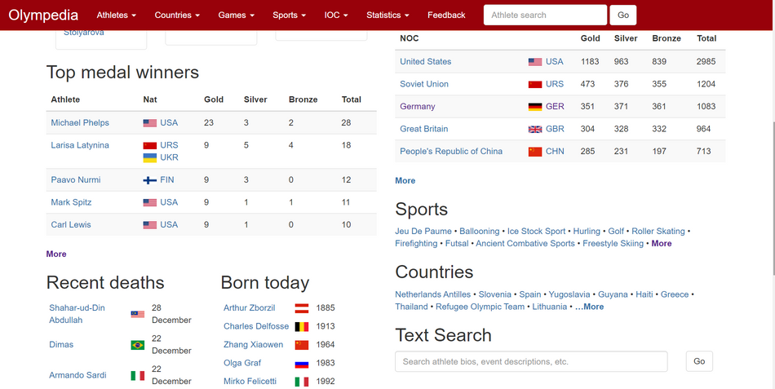

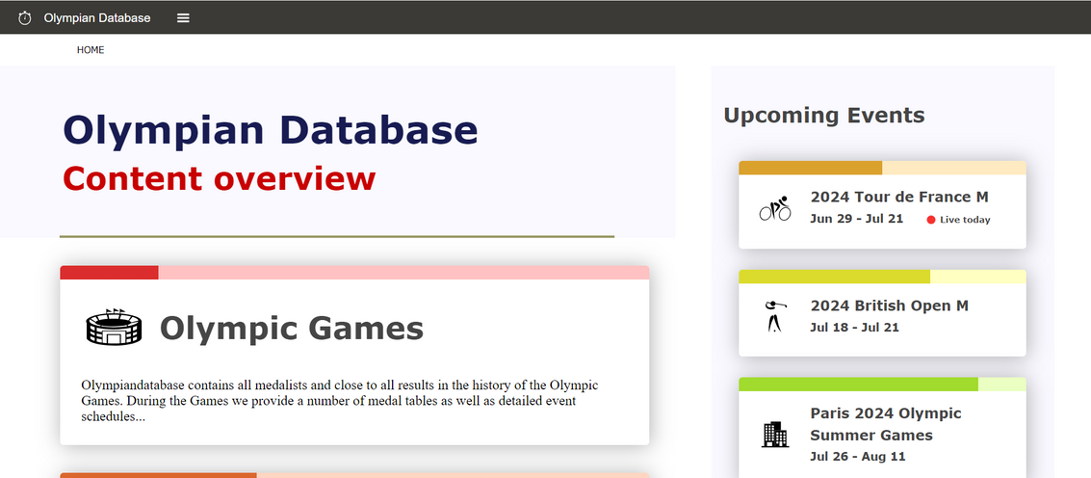

DATA SOURCES
HTTPS://WWW.OLYMPEDIA.ORG/STATISTICS/MEDAL/ATHLETE
SERVICE 02
HTTPS://WWW.OLYMPIANDATABASE.COM/INDEX.PHP?ID=387086&L=1
HTTPS://WWW.ESPN.COM/
16.07.2024 SRH Hochschule Heidelberg – Data Engineering 1
6

Slide 7



Creating correct schema with proper foreign keys and primary keys
Ubuntu machine was crashing due to lack of storage
Challenges Faced
INTRODUCTION
Scraping Dyanmic websites was a challenge
Equal Distribution of Files in HDFS
Reducing the size of the videos
16.07.2024 SRH Hochschule Heidelberg – Data Engineering 1
7

Slide 8

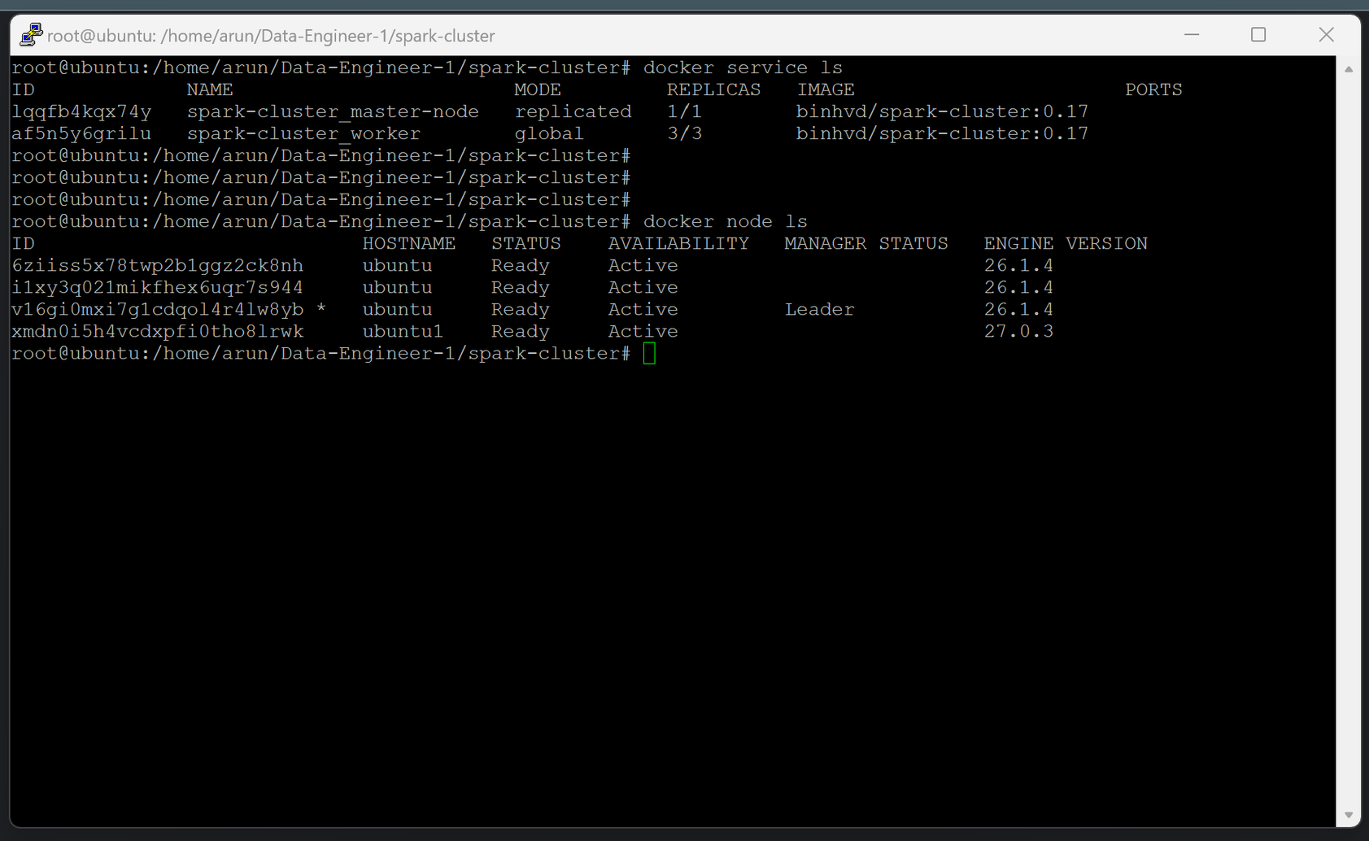
HADOOP CLUSTERING
16.07.2024 SRH Hochschule Heidelberg – Data Engineering 1
8

Slide 9
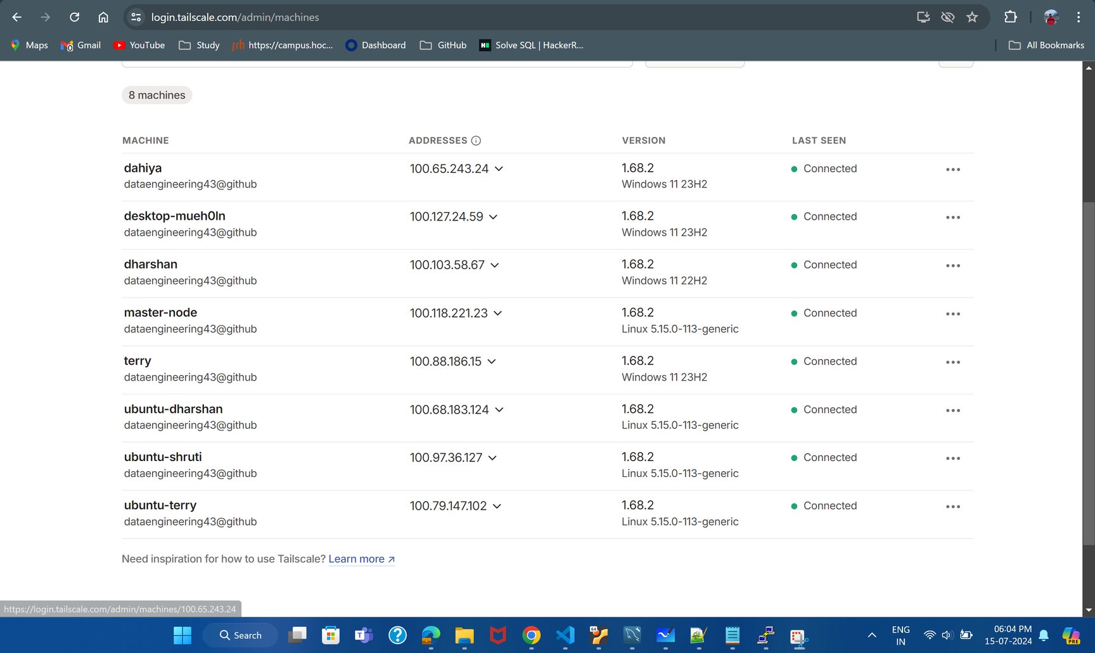
HADOOP CLUSTERING
16.07.2024 SRH Hochschule Heidelberg – Data Engineering 1
9

Slide 10
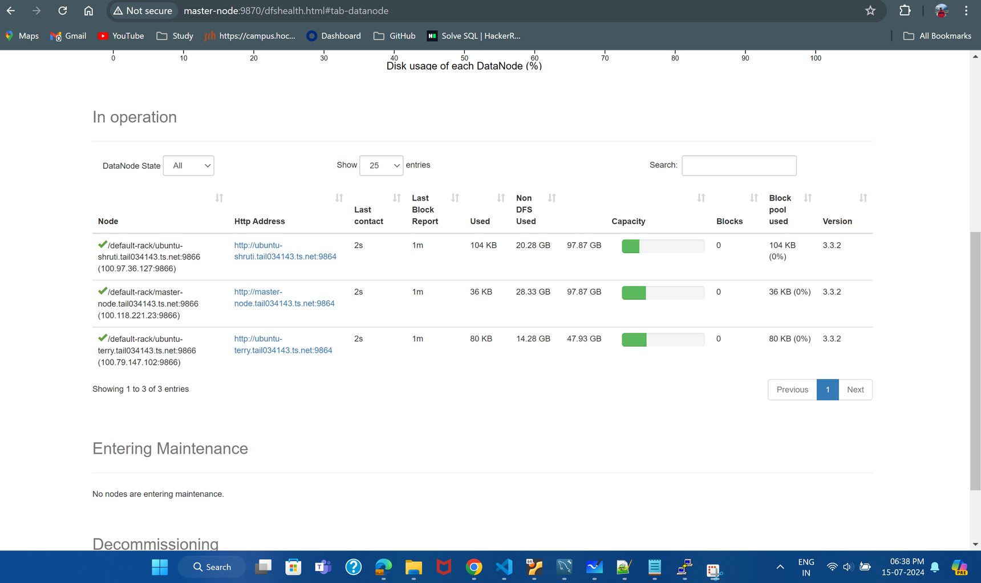
HADOOP CLUSTERING
16.07.2024 SRH Hochschule Heidelberg – Data Engineering 1
10

Slide 11
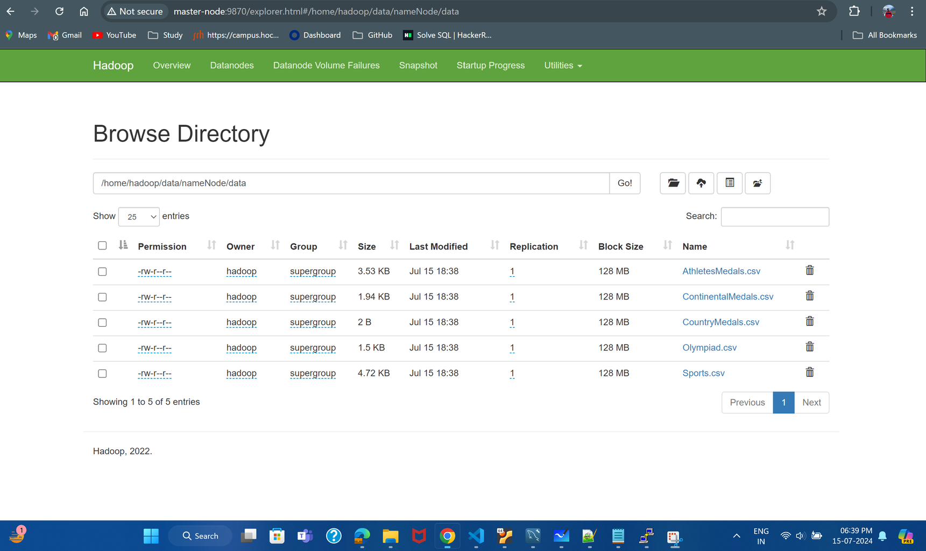
HADOOP CLUSTERING
16.07.2024 SRH Hochschule Heidelberg – Data Engineering 1
11

Slide 12

WEB SCRAPPING
We have scrapped data from below three websites.
https://www.olympedia.org/statistics/medal/Athlete
https://www.olympiandatabase.com/index.php?id=387086&L=1
https://www.espn.com/
WEBSCRAPPING METHODS
Selenium-used for web scraping to automate data collection from websites, just like a user browsing. It helps grab data from sites that need clicks or form inputs.
16.07.2024 SRH Hochschule Heidelberg – Data Engineering 1
12

Slide 13

DATABASE SELECTION?
MySQL Database.
WHY THIS DATABASE?
MySQL is chosen for its ease of use, reliability, cost-effectiveness, strong community support, performance, scalability, and security. Other databases, while powerful, may be more complex, expensive, or not as well-suited for the specific needs of this project.
16.07.2024 SRH Hochschule Heidelberg – Data Engineering 1
13

Slide 14
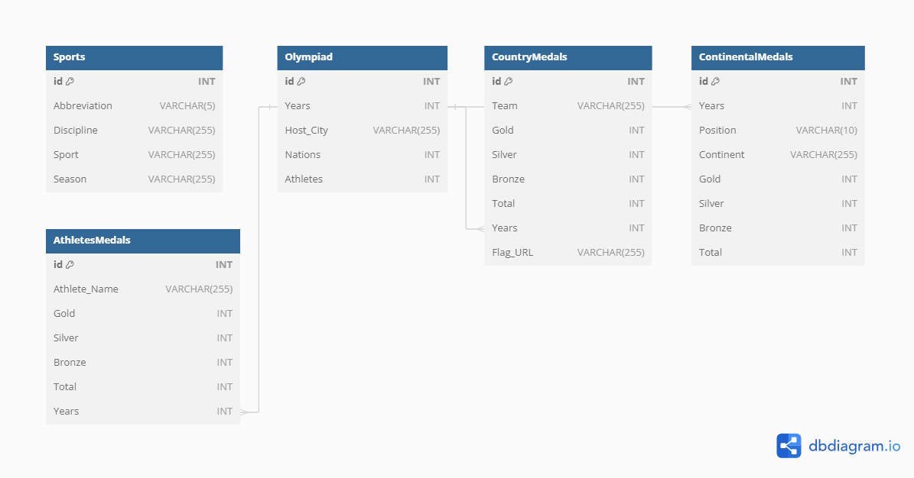
ER DIAGRAM
16.07.2024 SRH Hochschule Heidelberg – Data Engineering 1
14

Slide 15
BUSINESS QUERY-1
1. Retrieve all sports disciplines and their corresponding seasons:
SELECT DISTINCT Discipline, Season
FROM Sports
ORDER BY Season, Discipline;
BUSINESS QUERY-2
2. Find the host city and details of the Olympiad for a given year:
SELECT Years, Host_City, Nations, Athletes
FROM Olympiad
WHERE Years = 2020;
15
16.07.2024 SRH Hochschule Heidelberg – Data Engineering 1

Slide 16
BUSINESS QUERY-3
3. Get the total medal count for each country in a specific year:
SELECT Team, Gold, Silver, Bronze, Total
FROM CountryMedals
WHERE Years = 2008
ORDER BY Total DESC;
BUSINESS QUERY-4
4. List all athletes and their medal counts for a given Olympiad year:
SELECT Athlete_Name, Gold, Silver, Bronze, Total
FROM AthletesMedals
WHERE Years = 2004
ORDER BY Total DESC;
16
16.07.2024 SRH Hochschule Heidelberg – Data Engineering 1

Slide 17
BUSINESS QUERY-5
5. Summarize the total number of medals won by each continent in a specific year:
SELECT Continent, SUM(Gold) as Total_Gold, SUM(Silver) as Total_Silver,SUM(Bronze) as Total_Bronze, SUM(Total) as Grand_Total
FROM ContinentalMedals
WHERE Years = 2012
GROUP BY Continent
ORDER BY Grand_Total DESC;
BUSINESS QUERY-6
6. Compare the performance of a specific country across all Olympics:
SELECT cm.Team, cm.Gold, cm.Silver, cm.Bronze, cm.Total, o.Years, o.Host_City
FROM CountryMedals cm
JOIN Olympiad o ON cm.Years = o.Years
WHERE cm.Team = 'United States'
ORDER BY o.Years;
17
16.07.2024 SRH Hochschule Heidelberg – Data Engineering 1

Slide 18
BUSINESS QUERY-7
7. Identify the top-ranked continent based on total medals for a given year:
SELECT Continent, Gold, Silver, Bronze, Total
FROM ContinentalMedals
WHERE Years = 2016
AND Position = '1';
BUSINESS QUERY-8
8. Find the Olympics with the highest number of participating nations and athletes:
SELECT o.Years, o.Host_City, o.Nations, o.Athletes, cm.Gold, cm.Silver, cm.Bronze, cm.Total
FROM Olympiad o
LEFT JOIN ContinentalMedals cm ON o.Years = cm.Years AND cm.Continent = 'Asia'
ORDER BY o.Nations DESC, o.Athletes DESC
LIMIT 1;
18
16.07.2024 SRH Hochschule Heidelberg – Data Engineering 1

Slide 19
BUSINESS QUERY-9
9. List the top athletes with their medal counts and the corresponding Olympic host city:
SELECT am.Athlete_Name, am.Gold, am.Silver, am.Bronze, am.Total, o.Host_City, o.Years
FROM AthletesMedals am
JOIN Olympiad o ON am.Years = o.Years
ORDER BY am.Total DESC
LIMIT 10;
19
16.07.2024 SRH Hochschule Heidelberg – Data Engineering 1

Slide 20
REFERENCES
https://www.olympedia.org/statistics/medal/Athlete
https://www.olympiandatabase.com/index.php?id=387086&L=1
https://www.espn.com/
dbdiagram.io
Prof.Binh Vu for providing the docker Image
16.07.2024 SRH Hochschule Heidelberg – Data Engineering 1
20

Slide 21



THANK
YOU
reallygreatsite.com
21
16.07.2024 SRH Hochschule Heidelberg – Data Engineering 1

Slide 22
ANY QUESTIONS?
22
16.07.2024 SRH Hochschule Heidelberg – Data Engineering 1

